Slide 1

Implementation (and analysis) of a location based community organizer
Practical course Advanced Networking (Ws14/15)
Supervised by : David Koll
Presented by :
Hari Raghavendar Rao Bandari(11334055)
Seshagiri Prabhu(21410690)

Slide 2



Introduction :-
A location based community organizer.
Users could share their current physical location information to others in a community
Tracks location
Tom is 10 M away
Bob
Server
Bob is 10 M away
Tom

Slide 3
Anyone in the community can create an event and that event will be shared in the community( Ex: Instant Event “Meeting at central Mensa”).
Meeting at central Mensa
Meeting at central mensa
Meeting at central mensa
Server
Meeting at central mensa

Slide 4
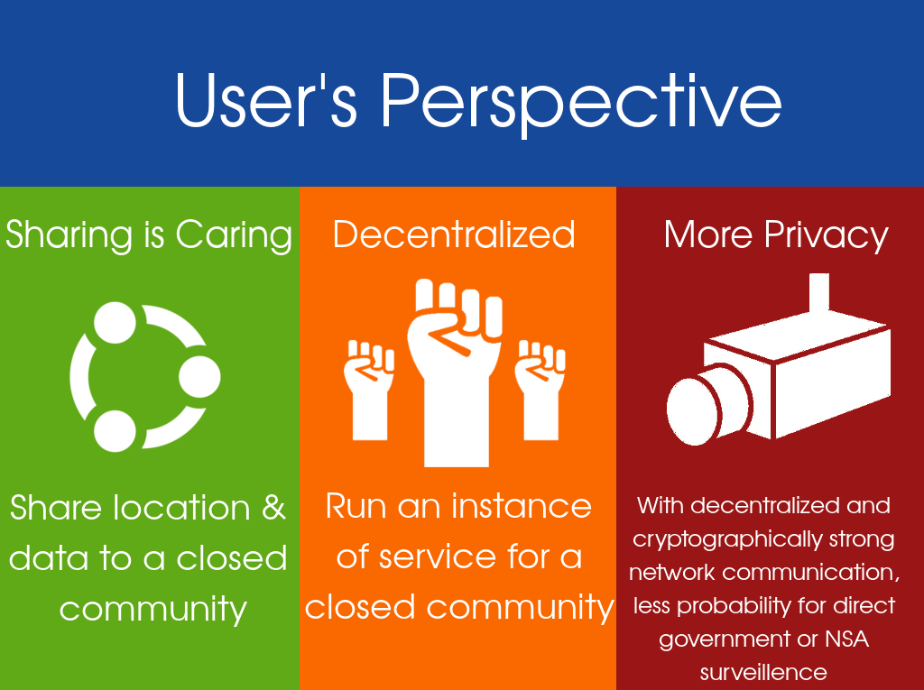

Slide 5
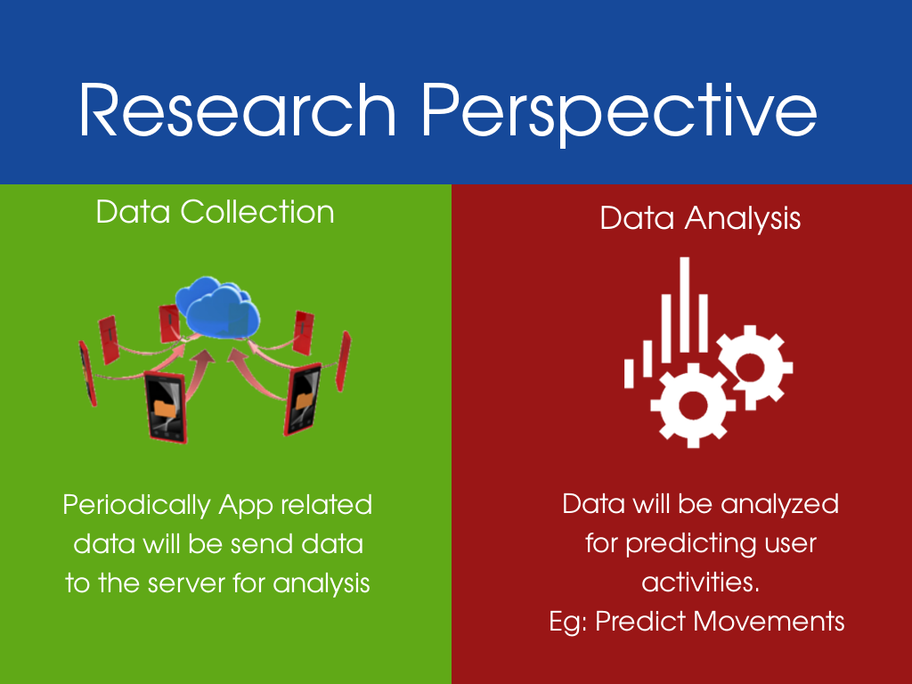

Slide 6
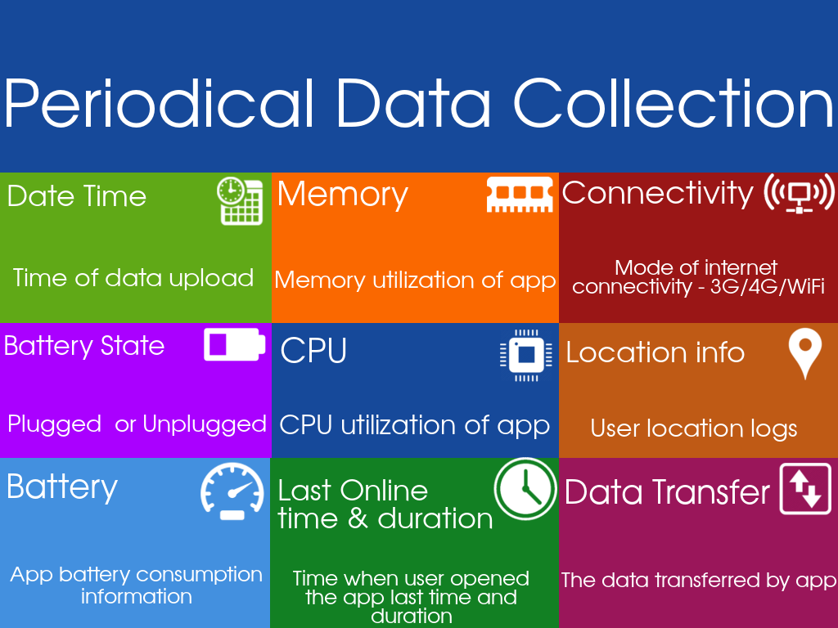

Slide 7
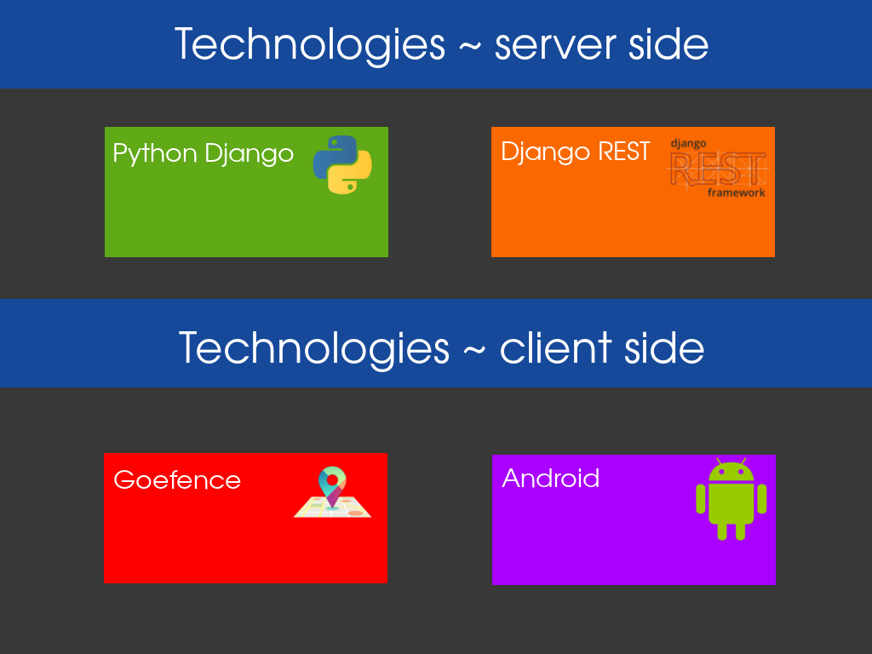

Slide 8

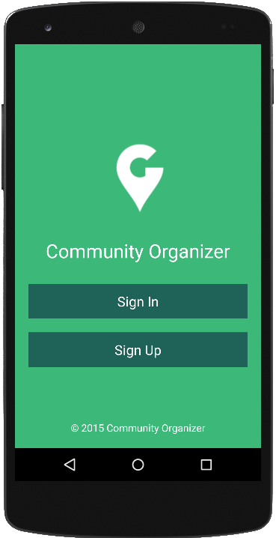

Architecture:-
INTERNET
Retrofit REST Client
JSON
Web Server
Android Client
Implementation(and analysis) of a location based community organizer
26/2/2015
Data Base
MySQL

Slide 10
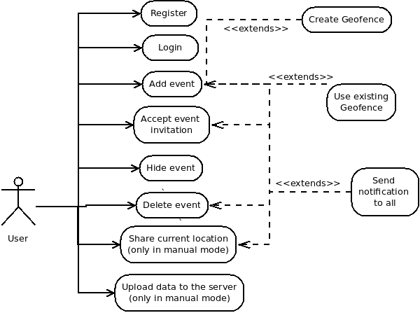
Use Case Diagram:

Slide 11
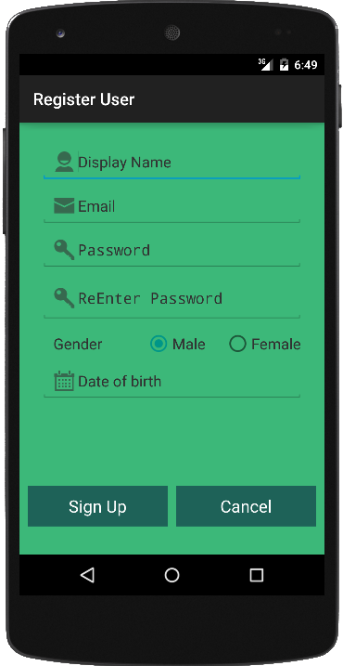
Android Application: Community Organizer
Implementation(and analysis) of a location based community organizer
26/2/2015

Slide 12
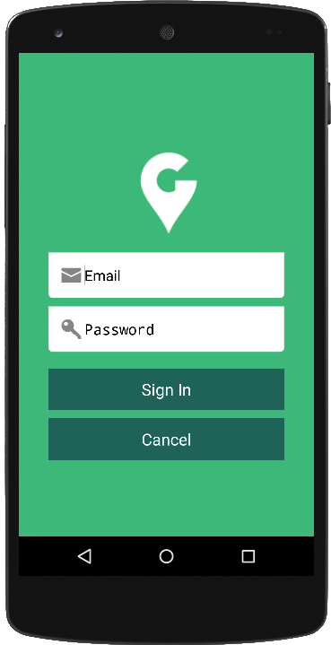
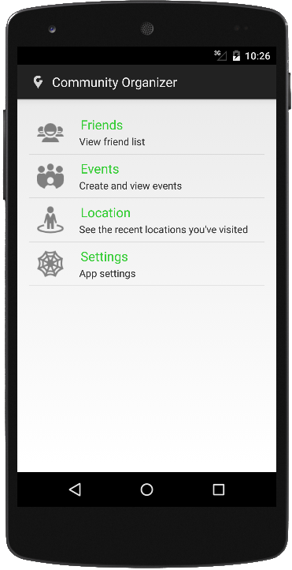
Sample Screen: SignIn & Home Activity
Implementation(and analysis) of a location based community organizer
26/2/2015

Slide 13
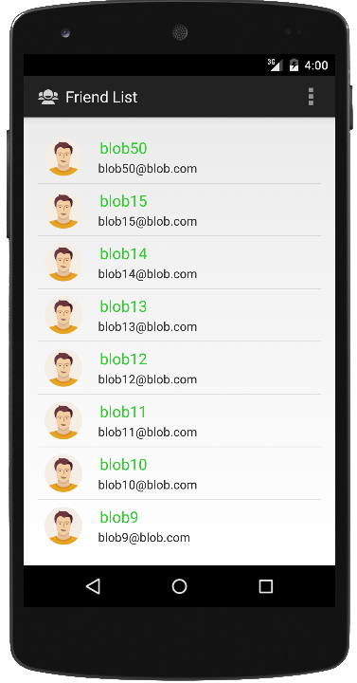
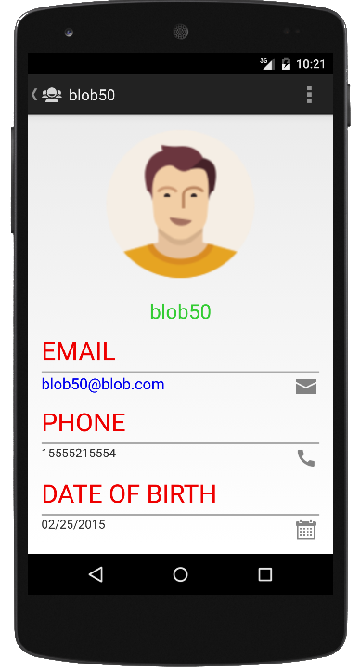
Sample Screen: Friend List
Implementation(and analysis) of a location based community organizer
26/2/2015

Slide 14
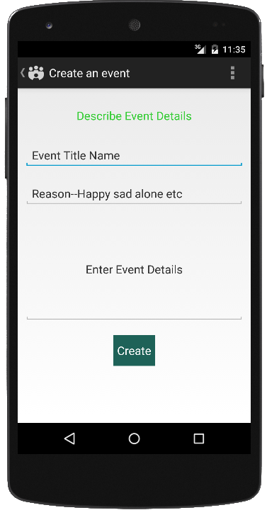
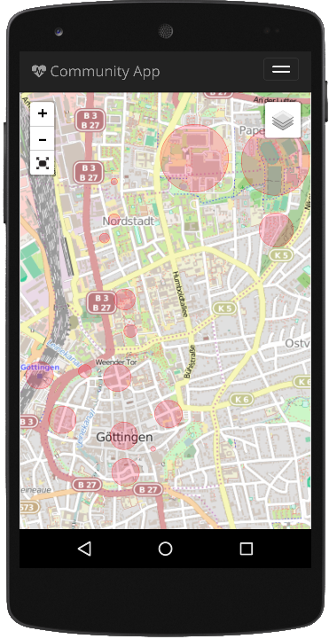
Sample Screen : Event Creation & Geofence User Map
26/2/2015
Implementation(and analysis) of a location based community organizer

Slide 16
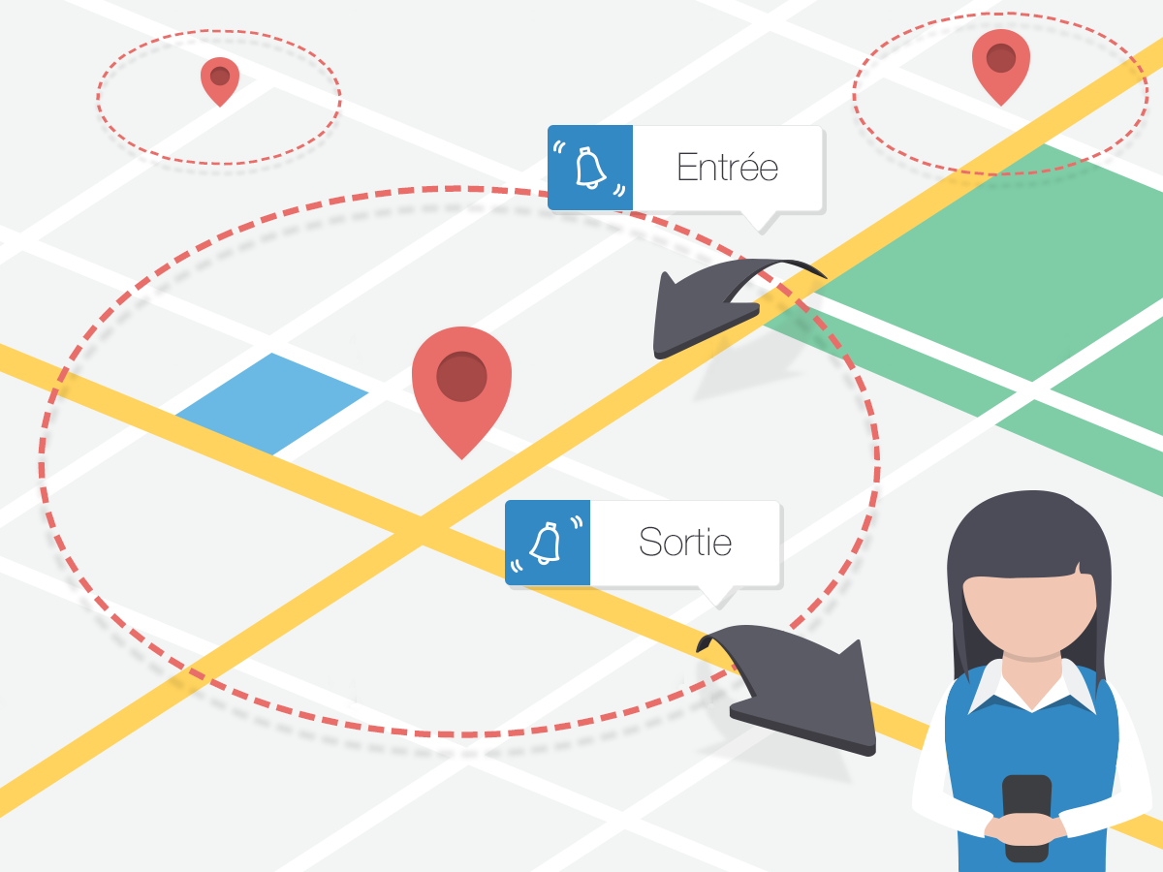
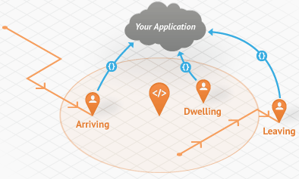
Geofence:
Geofencing is all about setting virtual areas and monitoring a smartphone entry and exit particular areas.
We can create as many virtual areas on map to track user location.

Slide 17
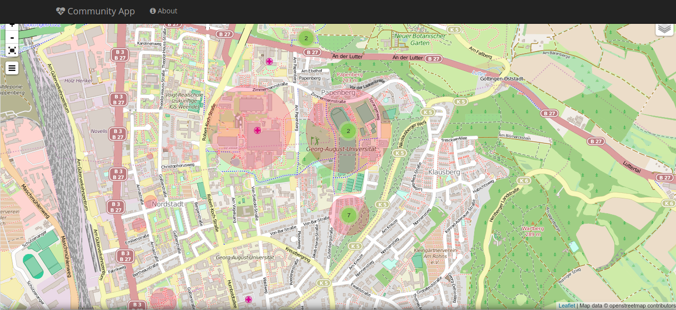
Server Screen:
Implementation(and analysis) of a location based community organizer
26/2/2015

Slide 18
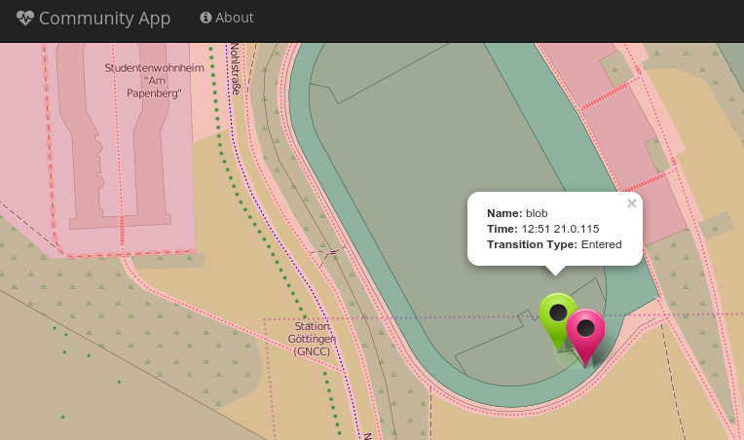
Sample : Blob (Entered) In Geofence
Implementation(and analysis) of a location based community organizer
26/2/2015

Slide 19
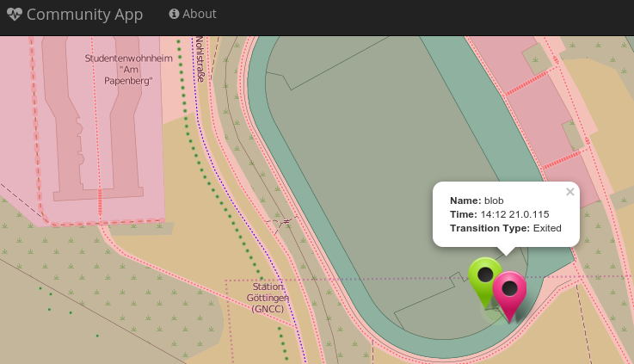
Sample : Blob ( Exited) from Geofence
Implementation(and analysis) of a location based community organizer
26/2/2015

Slide 20
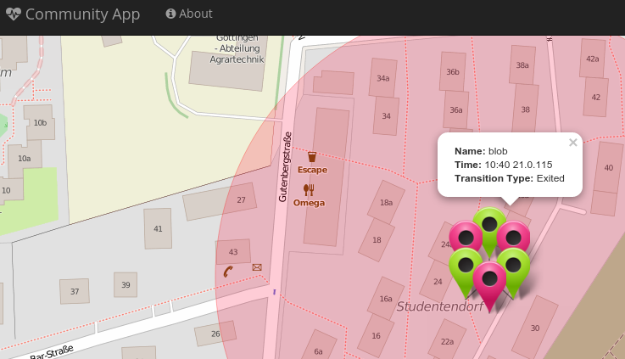
Sample : User Multiple Entries/Exits
Implementation(and analysis) of a location based community organizer
26/2/2015

Slide 21
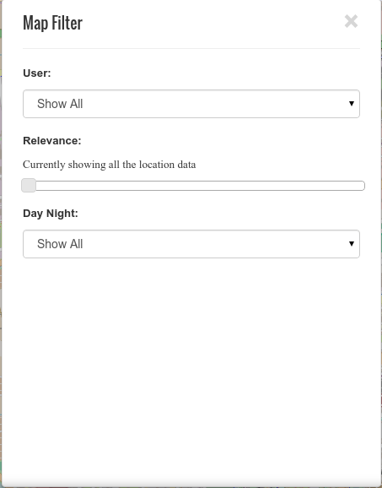
Server Side Data Analysis:
Implementation(and analysis) of a location based community organizer
26/2/2015

Slide 22
Challenges:
Server Side(Django REST framework):
Identifying Suitable
API’s, : Used Third Party API’s
For “Django REST framework”.
Client Side(Android):
Software fragmentation: Different version of Android
Hardware fragmentation:Different Screen shapes and Sizes.
Server connectivity problems.
Implementation(and analysis) of a location based community organizer 26/2/2015

Slide 23
Project Source Code:
Server Side:
https://github.com/seshagiriprabhu/community-serverapp
Client Side:
https://github.com/HariRaghavendarRaoBandari/CommunityOrganizerApp
Website:
https://seshagiriprabhu.github.io/Community-AndroidApp/

Slide 24
References:
N. Ding, et al.: "Characterizing and Modeling the Impact of Wireless Signal Strength on Smartphone Battery Drain", ACM SIGMETRICS 2013 [pdf]
Dmitry Namiot and Manfred Sneps-Sneppe: Geofence and Network Proximity, Springer Verlang Berlin Heidelberg 2013 [pdf]
K. Athukorala et al: “How Carat Affects User Behavior: Implications for Mobile Battery Awareness Applications”, ACM CHI’14 [pdf]
Daniel Wagner, Andrew Rice and Alastair Beresford, Device Analyzer: understanding smartphone usage, 10th International Conference on Mobile and Ubiquitous Systems: Computing, Networking and Services, Tokyo, Japan, December 2013 [pdf]
Daniel Wagner, Andrew Rice and Alastair Beresford, Device Analyzer: Large-scale mobile data collection, Big Data Analytics workshop (in conjunction with ACM Sigmetrics 2013), Pittsburgh, PA, USA, June 2013 [pdf]

Slide 25
Thank You

Slide 26
Any Questions?

